Slide 1
Cell Theory
Introduction

Slide 2
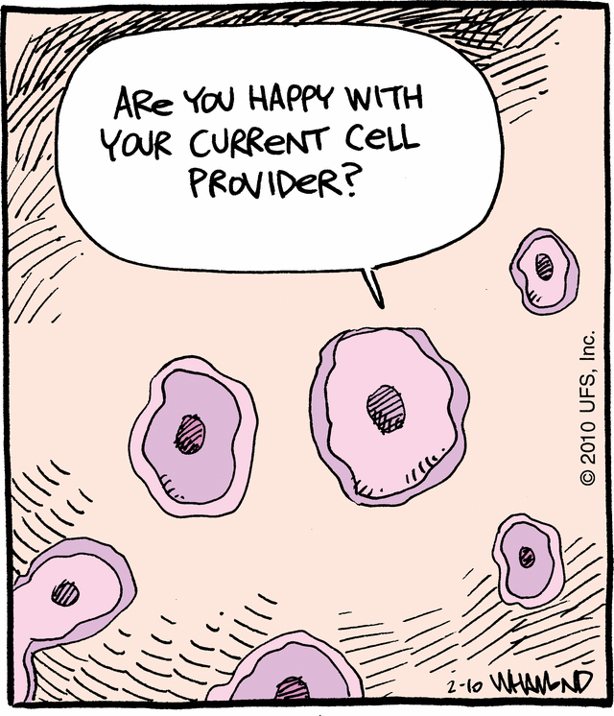
Objectives: Identify the parts of the cell theory and scientist contributions.
Do Now: Which items contain cells and which do not? Explain your answer.
Rocks Telephone Pole
Grass Grasshopper
Soil water
Homework: creative writing

Slide 3
Cellular Organization
Cells → Tissues → Organs → Organ Systems
The smallest unit of life: Skin Cell | Made up of many of the same cells: Skin Tissue | Made up of many different tissues: Stomach | Made up of many different organs: Digestive System

Slide 4
http://learn.genetics.utah.edu/content/begin/cells/scale/
Important events in the discovery of the cell and the development of the cell theory…..

Slide 5
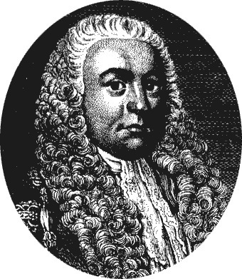
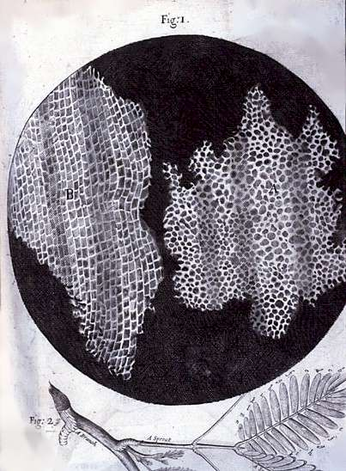
1665 – Robert Hooke
Observed cells in cork
Coined the term “cells”
Cork Cells

Slide 6
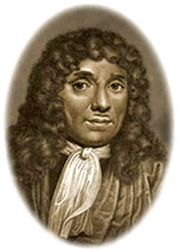
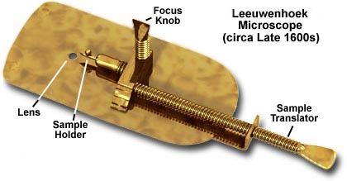
1673 – Anton van Leeuwenhoek
Observed pond water
Created a powerful microscope
http://www.youtube.com/watch?v=ApWNY7WsFOw

Slide 7
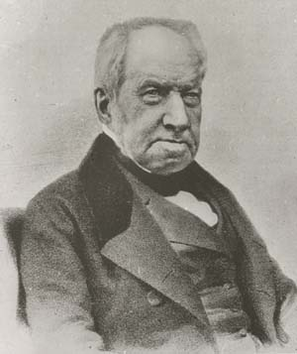
1827-33 – Robert Brown
Noticed that pollen grains in water jiggled around
Called “Brownian motion”
Discovered the nucleus
Nucleus
Human Cheek Cell

Slide 8
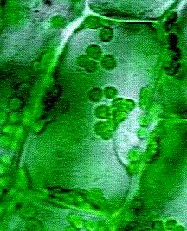
1838 – Matthias Schleiden
A botanist who concluded that all plants are made of cells.
Typical Plant Cell

Slide 9
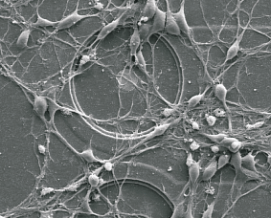
1839 – Theodor Schwann
A zoologist who concluded that all animals are made of cells.
Nerve Cells

Slide 10
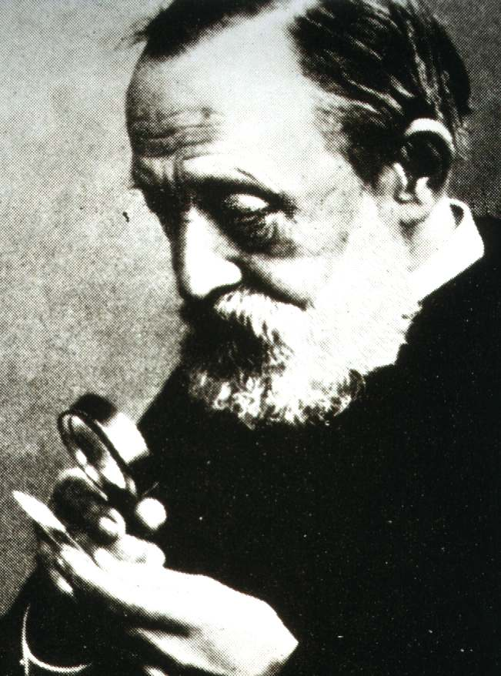
1855 – Rudolf Virchow
A physician who did research on cancer cells and concluded: “Ominis cellula e cellula”
“All cells are from other pre-existing cells.”
http://www.youtube.com/watch?v=NVfqzSKa_Bg

Slide 11
The Cell Theory
1. All living things are made of one or more cells.
2. Cells are the basic units of structure and function in organisms.
3. All cells arise from pre-existing cells.

Slide 12
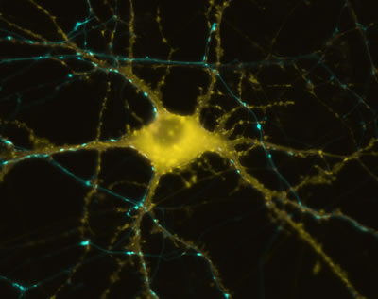
Cells are diverse…
In size, shape, and internal organization.

Slide 13
Creative Writing:
Write either a Poem, Song or Children’s Story
Include the scientists who helped develop the cell theory
Include how the theory was developed
Include the three statements of the Cell Theory
Create a Title and Submit neatly written on lined paper
Appropriate illustrations always welcome

Slide 14
Ted Ed: Wacky Cell Theory
http://ed.ted.com/lessons/the-wacky-history-of-cell-theory

Slide 15
Cell Size
Must remain small in size
SA:V
Surface Area - total area of the surface of an object
(Length x width) x sides
Volume – total space inside an object
Length x width x height

Slide 16
SA:V

Slide 17
So What???
As cell increases in size, surface area becomes too small to support internal structures
Oxygen and other nutrients cannot diffuse fast enough
Cells will divide
Exchange of nutrients quicker over short distances!!
Cell dies if nutrients are not received fast enough
How can a round cell increase surface area but not volume???
Notes:
Cells will have more demands and cannot meet those demands

Slide 18
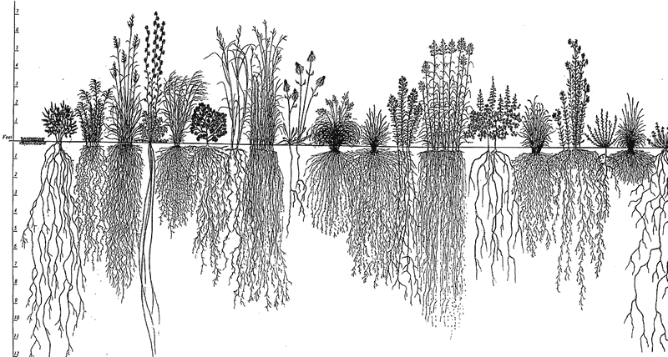
Examples of SA:V
Flowering plants have an extensive, branched rooting system to absorb water and minerals

Slide 19
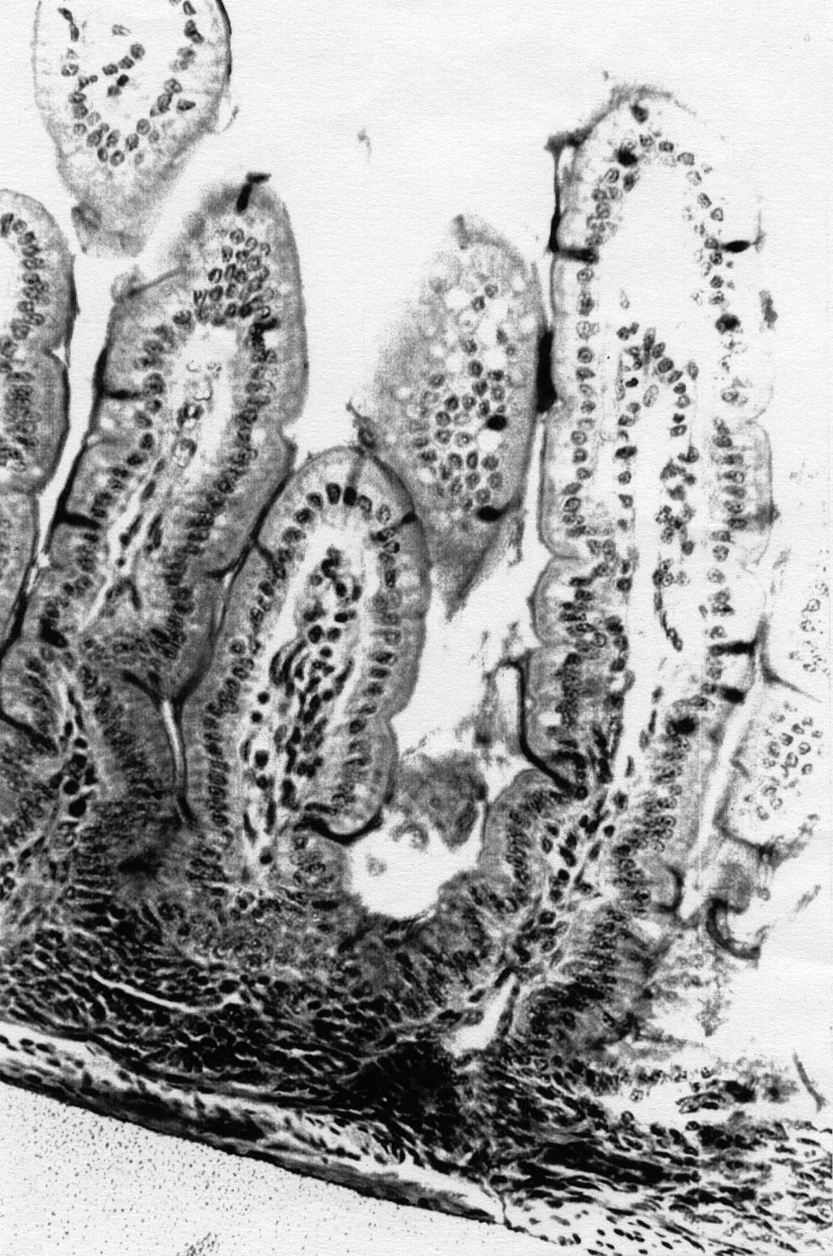
Examples of SA:V
Mammals have a long small intestine with internal folding to absorb digested food
Image Credit C. Candalh, INSERM

Slide 20
Objectives: Compare the structures of prokaryotic and eukaryotic cells. Describe the structure of cell membranes.
Do Now: Create a timeline in your notes, add to it the scientists we learned about yesterday and one word to describe their contribution
Homework: Formation of cell theory worksheet

Slide 21
Two types of cells
Prokaryote
Simple cells that do not have internal membranes
Ex. bacteria
Eukaryote
More complex cells that do have membrane-bound internal structures
Ex. Plant and animal cells

Slide 22
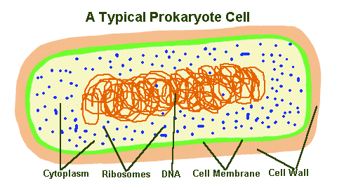
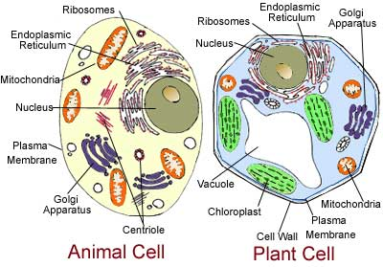
Bacterial Cell

Slide 23
Main differences
Prokaryotic
Eukaryotic
Few internal structures
No nucleus
DNA not organized into chromosomes
Unicellular organisms
Membrane-bound organelles
Have a nucleus
DNA organized into chromosomes
Most living organisms

Slide 24
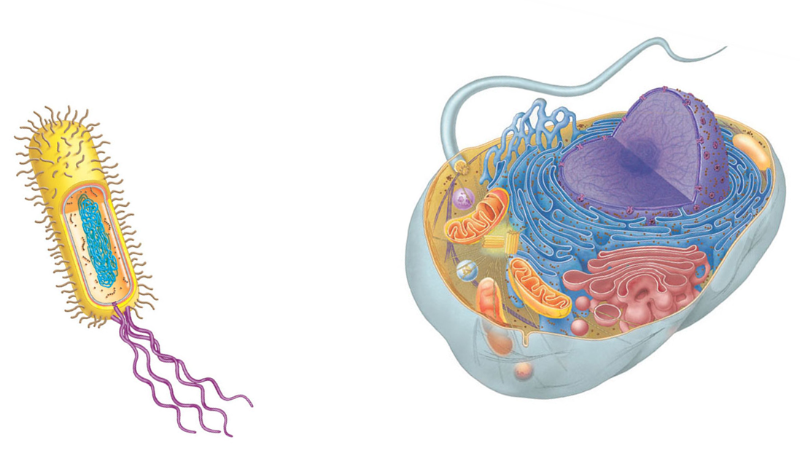
Prokaryotes and Eukaryotes (all cells, really) have several structures in common:
DNA
Ribosomes
Plasma
Membrane
Cytoplasm

Slide 25
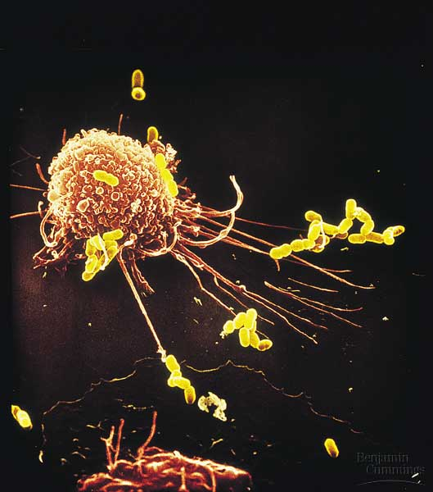
Eukaryotic
Prokaryotic

Slide 26
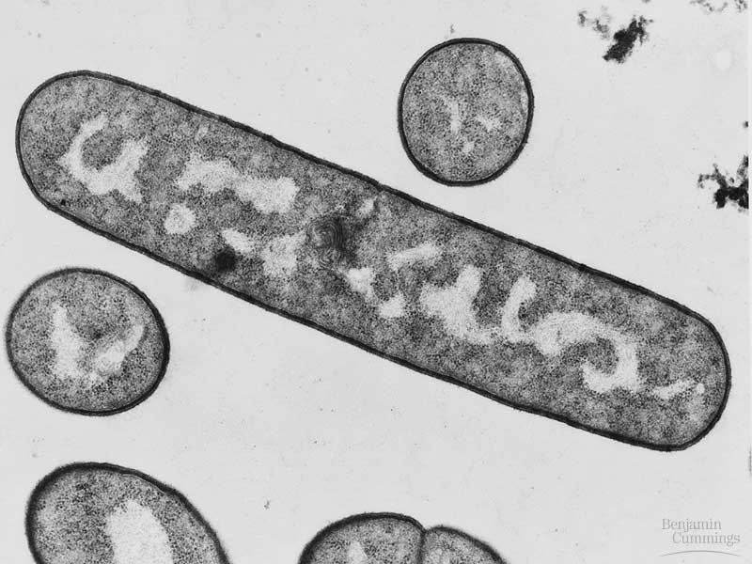
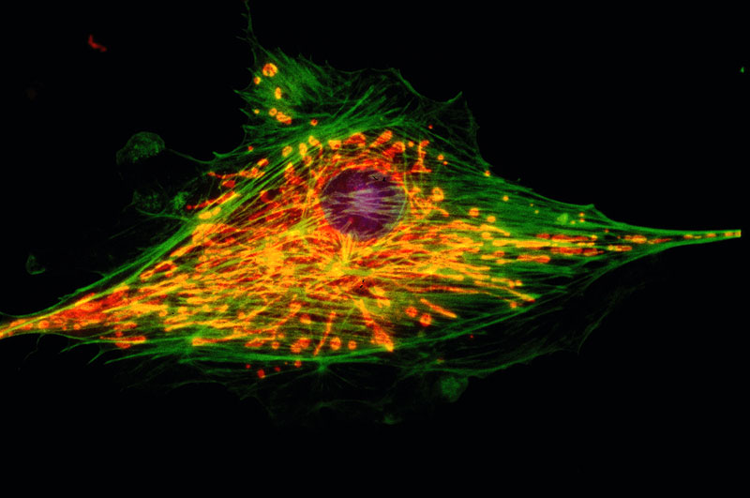
Prokaryotic
Eukaryotic

Slide 27
Cell Types
Prokaryote
1st to evolve
Lacking Nucleus
Simple Cell
Ex: Bacteria
Eukaryote
Cells contain Nucleus
Larger and more complex
Highly Specialized
Both
Have DNA and
Cell
Membranes

Slide 28
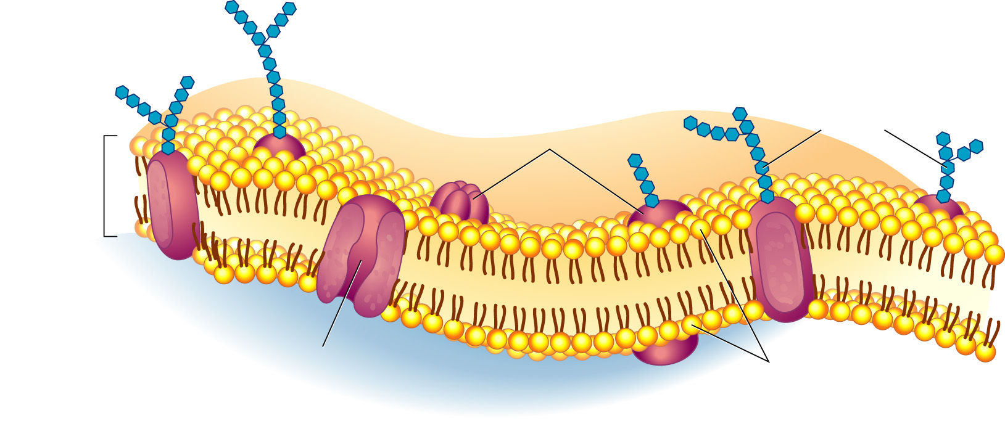
Cell Membrane
Plasma Membrane
Made of phospholipids and proteins
Selectively permeable
Outside
of cell
Carbohydrate
chains
Proteins
Cell
membrane
Inside
of cell
(cytoplasm)
Protein
channel
Lipid bilayer
Image from: © Pearson Education Inc, Publishing as Pearson Prentice Hall; All rights reserved

Slide 29
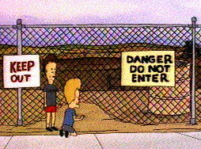
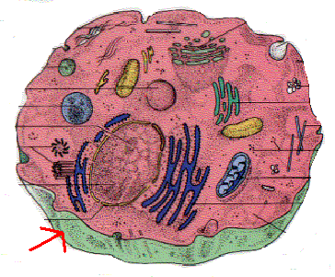
What does it do??
Acts as a boundary
Controls what enters/leaves cell

Slide 30
Phospholipids
HYDROPHILIC →
HYDROPHOBIC →
Image by Riedell

Slide 31
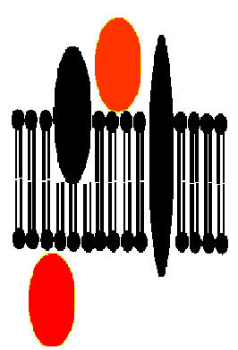
Membrane Proteins
Peripheral –stick on the surface
Inside or outside cell
Integral – stick into the membrane
Can go part way or all the way in

Slide 32
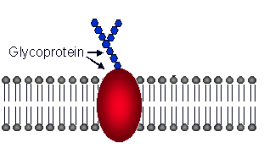
Glycoprotein
Proteins with carbohydrates attached

Slide 33
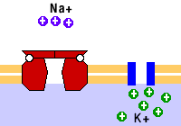
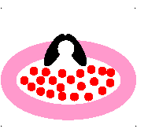
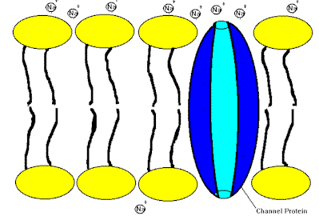
Transport Proteins
Helps move substances across cell membrane
Animations from: http://bio.winona.edu/berg/ANIMTNS/facdifan.gif
Notes:
Like an old lady crossing the street

